Slide 1

KeyLogger
and
Security
By
Dakkata Neeraja

Slide 2


AGENDA
Introduction
Problem Statement
Project Overview
Who Are the End Users
Our Solution
Value Proposition
The "Wow" Factor
Modelling
Results
Conclusion
3/21/2024 Annual Review

Slide 3

PROBLEM STATEMENT
Key Loggers: Software that records keystrokes to capture sensitive information.
Security Threats: Data theft, privacy invasion, and financial losses.
Prevalence: Widespread issue affecting both individuals and organizations.
3/21/2024 Annual Review

Slide 4

PROJECT OVERVIEW
Objective: Develop a keylogger to demonstrate potential security threats and inform about prevention.
Scope:
Creating a keylogger using Python.
Logging keystrokes and saving them in text and JSON formats.
Providing a simple GUI for starting and stopping the keylogger.
3/21/2024 Annual Review

Slide 5

WHO ARE THE END USERS?
Target Audience:
Security professionals
IT departments
General users concerned with personal security
User Needs:
Understanding keylogger functionality
Learning to detect and prevent keylogger attacks
3/21/2024 Annual Review

Slide 6

MY SOLUTION
Description: A keylogger program developed using Python.
Features:
Logs keystrokes to a text file and a JSON file.
Simple GUI for easy operation.
Technology:
Python
tkinter for GUI
pynput for keyboard event listening
json for data storage
3/21/2024 Annual Review

Slide 7
ITS VALUE PROPOSITION
Benefits:
Educates users about the workings of keyloggers.
Helps in understanding potential security risks.
Assists in developing countermeasures against keylogger attacks.
Unique Selling Points:
Easy-to-understand code and interface.
Real-time logging of keystrokes.
ROI:
Enhanced awareness and preparedness against keylogging threats.

Slide 8

THE “WOW” FACTOR
Innovation:
Combines educational value with practical demonstration.
Impact:
Significant in raising awareness about keylogger threats.
User Experience:
User-friendly interface for starting and stopping the keylogger.
3/21/2024 Annual Review
‹#›

Slide 9
MODELLING
Process:
Keylogger implemented using Python.
GUI developed using tkinter.
Keyboard events captured using pynput.
Techniques:
Event-driven programming for capturing keystrokes.
Data storage in text and JSON formats.
3/21/2024 Annual Review
‹#›

Slide 10
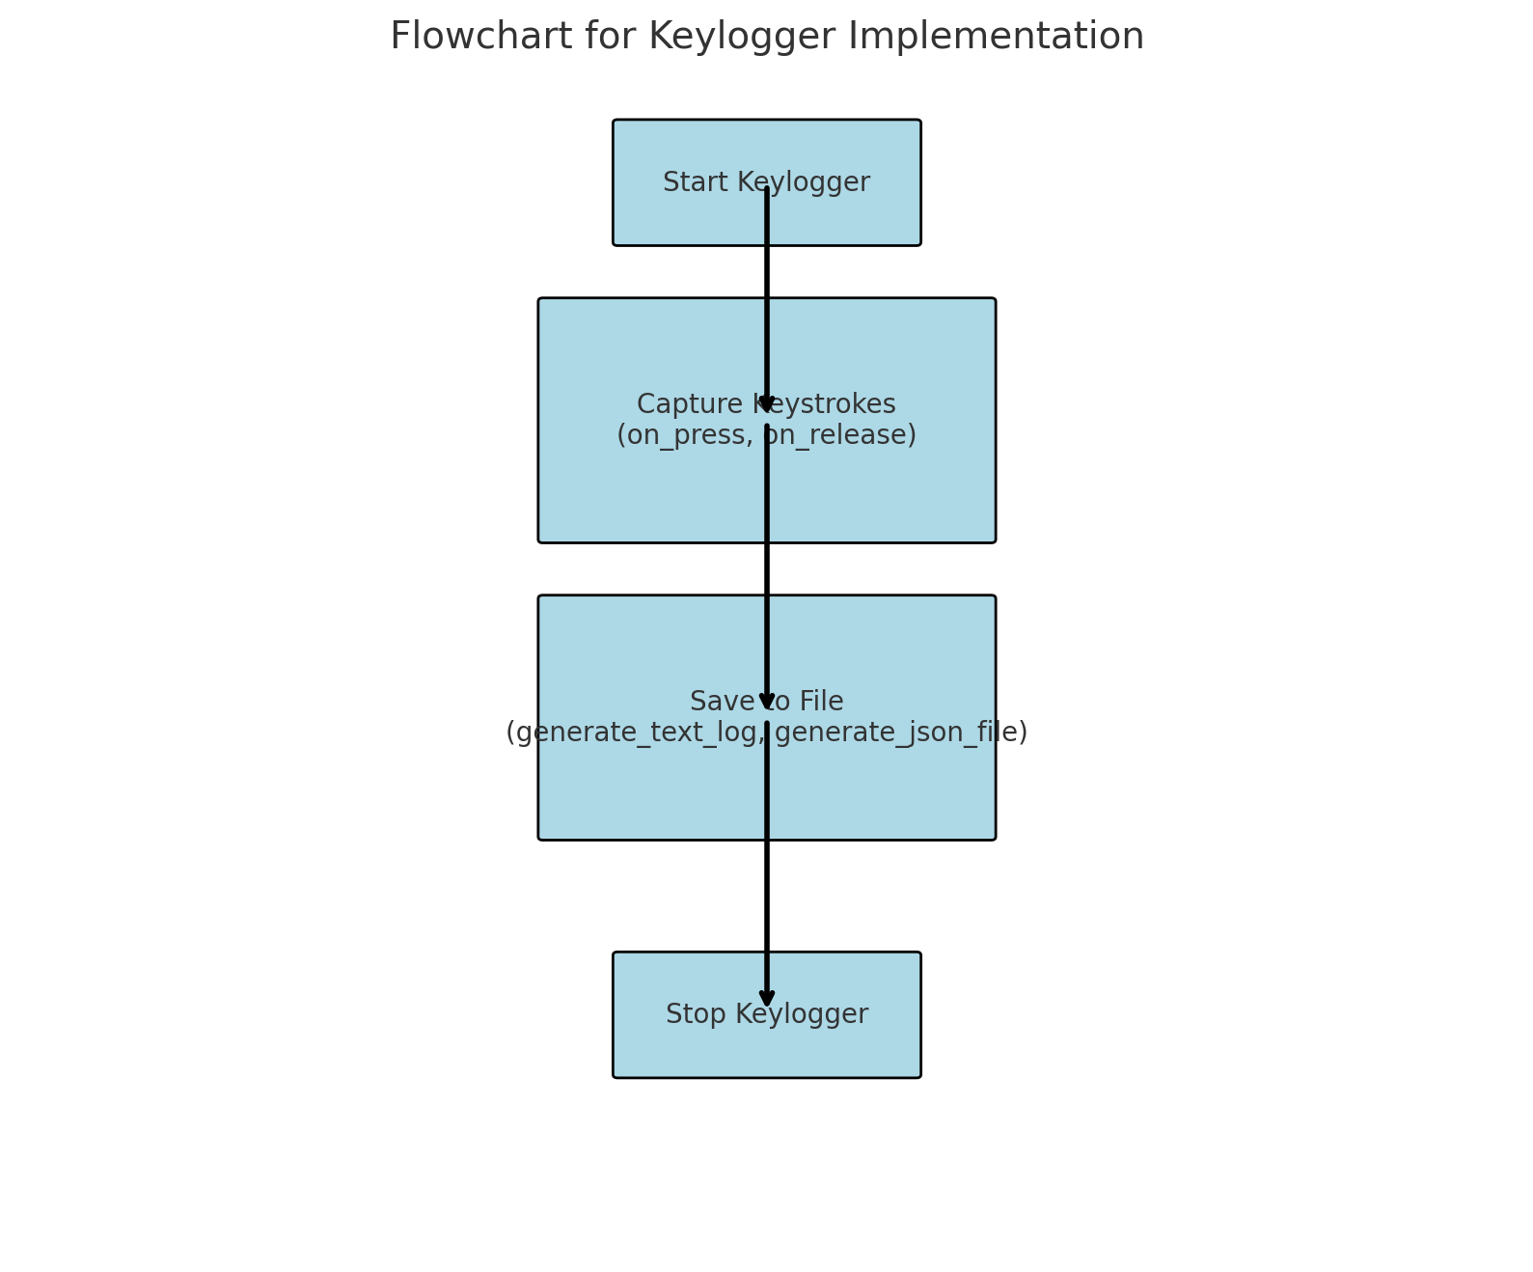
FLOW CHART

Slide 11
RESULTS
Findings:
Successfully logged keystrokes to both text and JSON files.
GUI provides easy control over keylogger operation.
Data:
Example of logged data in text and JSON files.
Demonstrate the effectiveness with sample keystrokes.
Case Studies:
Potential use in educational settings to show security risks.
3/21/2024 Annual Review
‹#›

Slide 12
CONCLUSION
Summary:
Keylogger demonstrates the ease of capturing keystrokes.
Highlights the importance of securing against keylogger threats.
Call to Action:
Encourage further learning and development of security measures.
Suggest steps to protect against keylogger attacks.
Thank You:
Thank the audience for their attention.

Slide 13
GIT HUB LINK FOR CODE
https://github.com/D-Neeraja/key_logger.git

